Slide 1
Welcome!
Karen Oliver-Spry - Hub Manager

Slide 2
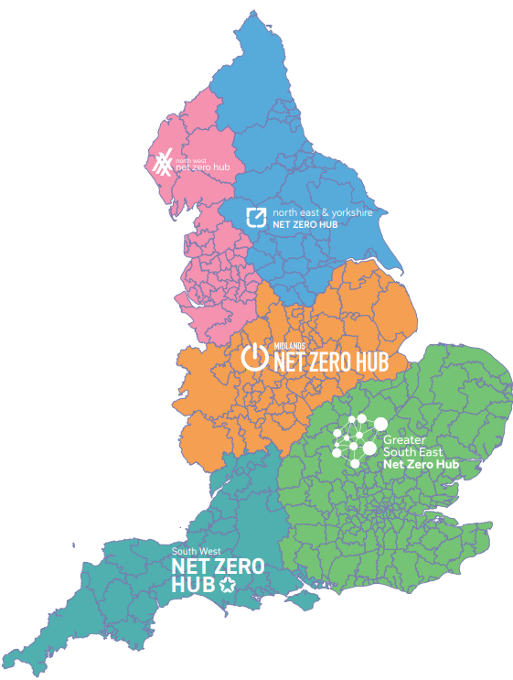
Local Net Zero Hubs
One of five Local Net Zero Hubs in England
Funded and directed by DESNZ as part of the Local Net Zero Programme
Purpose is to accelerate & realise local energy/ net zero ambitions​
Building capacity – access to time and expertise
A forum to aid understanding local energy/ net zero activity​

Slide 4
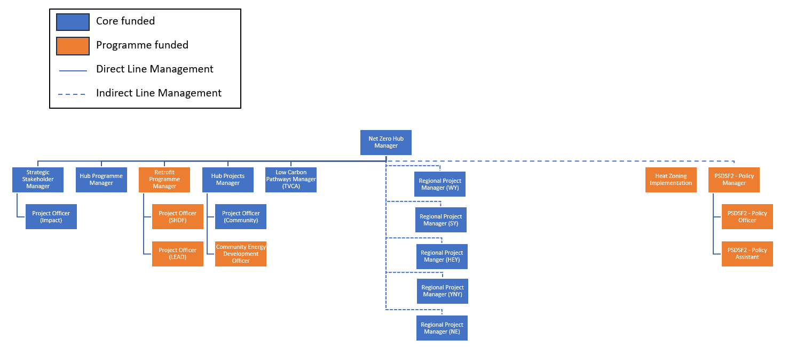

Slide 5
Hub Objectives
Attract commercial investment into projects.
Increase the number, quality, and scale of local Net Zero projects being delivered
Develop and support Net Zero elements to wider programmes
Improve information sharing, training, and evaluation
Raise local awareness of opportunities for local Net Zero investment

Slide 6
Key Successes
Supporting over 100 projects from solar powered ice rinks in Tees Valley to trams powered by their own braking systems here in South Yorkshire
Collaborated with 3Ci and partners to deliver our first Regional Investors Forum in Leeds
Administered over £1m of funding for community-led energy projects
Helped organisations get started on their decarbonisation journey with free carbon literacy training
Worked with partner Hubs to deliver a joint knowledge exchange webinar on internal carbon pricing which attracted 300 participants

Slide 7
Building Decarbonisation
Helped a crematorium in Doncaster become largely self-sufficient in clean energy and a community space in Masham become a demonstrator for sheep wool insulation
Produced research setting out routes for addressing regional retrofit skills needs and piloted some initial interventions.
Subsidised professional energy audits to help community organisations get started on their decarbonisation journey
Oversaw delivery of 6 innovative energy advice pilots
Facilitated energy improvements in over 8000 social and low-income homes through our regional retrofit programme delivery
Evaluated the experience of retrofit programmes to draw out learnings and recommendations that will inform future delivery

Slide 8
Looking Ahead
Further local capacity support for local net zero delivery, including:
Supporting local energy pathways work
Developing commercial investment models for solar
Identifying demonstrator projects for unlocking geothermal energy at scale
Embedding net zero in a new film studio production village
Contributing to external programmes such as Northern Powergrid’s pioneering Community DSO and the University-led Northern Net Zero Accelerator
Unlocking more small local authority and community led energy projects
Working with partners to lead a bid for what could be the Hub’s largest ever retrofit programme

Slide 9
Coming Soon…!

Slide 10
Heat Zone Implementation Support
Coordinating zoning communications to prepare LAs for heat zoning
Two-way communication – raising awareness of local needs and supporting informed decision making
Providing a critical link between local operations and national objectives - ensuring local activities align with broader strategic goals
Helping to plug gaps in local knowledge and preparedness for zoning.

Slide 11
Public Sector Decarbonisation Skills
Supporting development and critique of heat decarbonisation plans
Supporting development of investment grade proposals that can secure approvals, resource or funding.
Helping find ways to progress stalled or stymied plans
Maximising the use of available resources and toolkits to apply and embed best practice
Encourage peer learning and shared experience of what works

Slide 12
Enjoy the rest of the day!

