Slide 1
Inspiring Retrofit Projects
Lendology
York & North Yorkshire CA
Let Zero

Slide 2
Home Energy West Yorkshire

Slide 3
171,000 domestic solar PV systems to be installed to reach the net zero target

Slide 4
Framed within an overarching vision and three objectives

Slide 5
One Stop Shop
The OSS should...
be able to provide robust householder and property-specific advice and end-to-end support, applicable to every home in the area.
be able to offer an all-inclusive service.
interface seamlessly and flexibly with current and future programmes, actors and funding sources to enable households to benefit from whatever is the most appropriate mix of services, including those funded locally/directly by local government.
encourage retrofit and become the first point of reference for retrofit enquiries in the area.
Act as a ‘single front door’ for retrofit support.

Slide 6

Solar Together West Yorkshire
Budget:
£90k for supplier to deliver marketing campaign, enabling solar PV and battery storage installations.
Aimed at ‘able to pay’ residents, although costs to the residents will be reduced due to economies of scale achieved through collective buying
Outputs and Timescales:
Installing solar panels onto an estimated 600 homes across the region
Estimated 2.37MW of solar
Estimated CO2 savings - 564 tonnes per annum
Leverage an estimated £3.7m of private sector match funding
Market Research
Registration Open: July – September 2024
Installations: September 2024 – March 2025

Slide 7
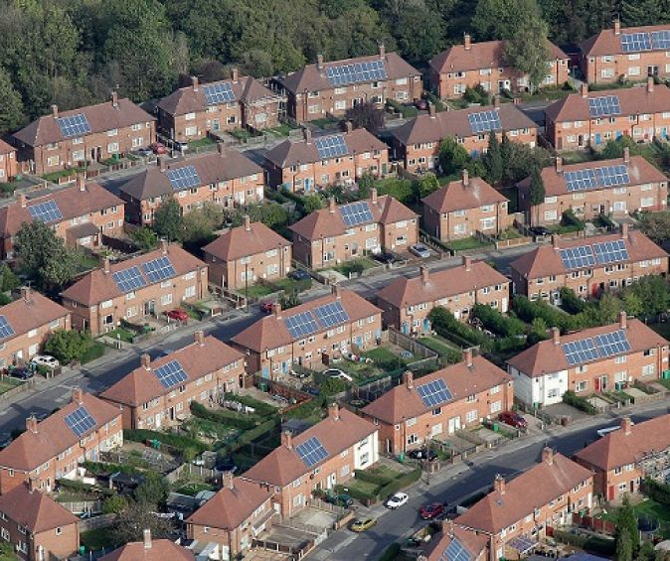
West Yorkshire Housing Partnership
Total Budget:
£15,000,000 to undertake project assurance activity and expand the scheme delivered by West Yorkshire Housing Partnership.
£5 million is CA gainshare funding
£10 million being provided for the scheme by the West Yorkshire Housing Partnership.
Outputs & timescales:
Installing solar panels on up to 1500 social housing properties across the region
Install 5.7MW of solar
Estimated CO2 savings - 805 tonnes per annum
Reduced electricity bills for the residents
Leverage up to £10m of private sector match funding

Slide 8
Social Housing Decarbonisation Fund (SHDF)
Wave 1: consortium of 9 RP's completed 916 properties to EPC C
Booster: as a response to the Energy and Cost of Living Crisis, a consortium of 8 RP's installed measures in 1743 properties with the aim of achieving thermal comfort. Properties were all located in areas of high deprivation. Delivery through co-funding and £5m Mayoral Gainshare.
Wave 2.1: consortium of 9 RP's forecasted to deliver 2162 properties to EPC C.

Slide 9
Warm Homes: Social Housing Fund
We are leading the development of a consortium bid, under the ‘Strategic Partner’ (SP) opportunity and our consortium has grown since Wave 2.1, from 9 partners to 14, ranging from large to small providers.
We are currently undertaking due diligence with our Registered Providers to ascertain our proposed unit numbers. Current thinking is around 6-8,000 units subject to technical scrutiny.
Ongoing conversations with RISE and the RP's to provide guidance on the approach and timescales.
Ideas of areas of guidance and support for the CA that is needed on it's SP application on the following:
Strategic Priority 1: strategies to harness economies of scale
Strategic Priority 3: support the development of the supply chain. DESNZ examples include: more apprenticeships/more training of RC's/RA's/Supporting contractors to become PAS/MCS/Trustmark accredited/increase use of SME contractors

Slide 10
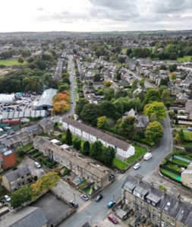
Area Based Schemes
Each district within West Yorkshire will deliver an area-based scheme (ABS) which will aim to test different technological, delivery and financial models, to tackle various challenges facing mixed multi-tenure (including landlords) communities, and create blueprints to enable scaling up at pace, and to accelerate demand.
Adopting an area-based approach will aggregate demand for works from the able-to-pay market and Private Rented Sector (PRS) as well as providing a cost-effective measure when installing measures to a particular street.
Phase 1 of the ABS: Taking a fabric first approach to reduce demand for heat and power through the introduction of insulation measures and where possible, installing low carbon technologies such as air source heat pumps and Solar PV.
Phase 2 of the ABS: Scaling up to a wider community/area or focus on a particular challenge that would prevent multi-tenure retrofit scale up.
A/W 25

Slide 11
Barriers to Scaling up
Commission creation of a Regional Heritage Guide to agree consensus
Skills and Training Provision
Reluctance of homeowners to embrace new technologies such as ASHP
Limits interventions that can be made, and delivery timescales
Reluctance of homeowners to push innovation
creation of a Just Transition plan to understand how to effectively engage and communicate with residents
Supply chain capacity
Planning Constraints
Technical Barriers
SCALE UP
ABS’s
Non-Technical Barriers
Infrastructure – Heating and Energy
Resident Refusals
Funding/Affordability.
Lack of National Policy
LAEP
DNO
creation of a Just Transition plan to understand resident engagement
Where possible, ABS pilot different financial mechanisms – blended finance, LIL, SHDF Wave 3

Slide 12
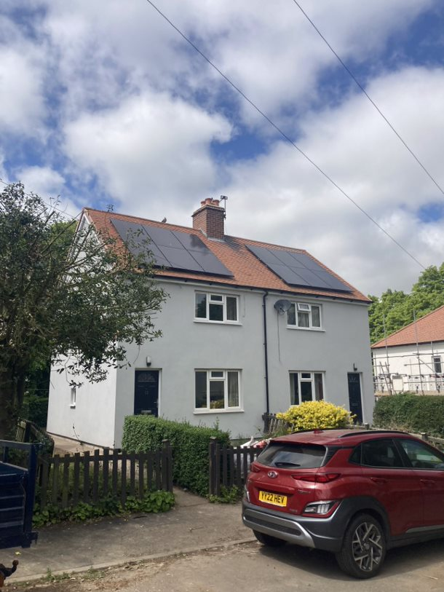
Low-interest Retrofit Loan
What we are doing: Providing low-interest loans to WY residents to support homeowners (including private landlords) with financing the retrofit of their property. We have procured social enterprise lender Lendology, who will manage and administer the loans on our behalf. The project has a £1.5 million loan pot, with loans provided at an interest rate of 3.26%.
Why we are doing it: Access to affordable finance is a significant barrier preventing people from retrofitting their home. Using our money means we can keep the interest rate much lower than high street loans, making the loan more affordable and accessible.
Details of the loan:
  Interest rate – 3.26% (3,29% APR representative)
  Loan values of £5,000 - £25,000
  10 year maximum loan term
Eligible measures: Insulation, ventilation and double / tripled glazed windows where paired with insulation, solar PV systems, solar thermal, batteries (when paired with solar), heat pumps, remediation work required to facilitate the install of eligible measures (e.g. redecorating post internal wall insulation).

Slide 13
Future Priorities
We are currently developing a 10-year plan for Home Energy West Yorkshire.
This will focus on the following workstreams:
Social Housing
  Including a Social Housing Investment Plan and social housing stock dashboard
Household Engagement
  Building awareness in West Yorkshire for retrofit and breaking down barrier to adoption.
Supply Chain Development
  To support the development of retrofit and renewable supply chain, workforce and skills infrastructure
Just Transition
  To ensure that all parts to society have access to the support they need to reduce their energy use
Retrofit Acceleration
  To identify opportunities to accelerate the sustainable and high-quality delivery of domestic retrofit.
In addition, there are 2 further workstreams on:
6. Policy and Influence
7. Monitoring and evaluation.

Slide 14
Activity – 2024/25
Launch of Home Energy Loan and Solar Together collective buying scheme.
Procurement of programme evaluator
Warm Homes: Social Housing Fund bid
Launch of Home Energy West Yorkshire Brochure site
Approval of funding for 3 further area-based schemes.
Closer of Solar Together, LEAD and SHDF 2.1.
Business case for enhanced loan.
Development of further financial offers.
Development of Home Energy West Yorkshire 10-year plan.
Development of Heritage Guide.
Oct 24
Feb 25
Jun 25
1
2
3
4
5
6
7
Nov 24
Mar 25
A/W 25
Jul 24
Procurement of delivery partner for design of one stop shop, strategic marketing partner, and digital platform build.
Procurement of retrofit coordinator to provide technical delivery support on ABS.
Programme evaluation begins.
WYHP Solar scheme begins.
Delivery begins on WYHP solar scheme.
Launch of Home Energy West Yorkshire one stop shop first phase, full website and marketing campaigns.
Completion of Social Housing Decarb Plan.

Slide 15












Slide 16

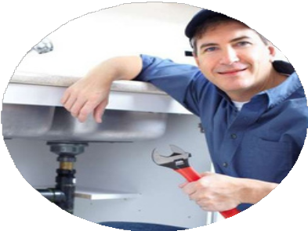

What makes us different?
Pensioners with limited or no disposable income
Self-employed
Homeowners in receipt of benefits
Representative Example (3.26% fixed interest rate, Representative 3.29% APR)
Borrow £15,000 over 10 years = £146.65 monthly repayments.
Total amount repayable = £17,617.80. This includes the £20.00 fee for registering the Title Restriction against your property at HM Land Registry. The £20.00
is only repayable if a loan is agreed by Lendology and you decide to proceed with a loan. We do not charge interest on the fee. A Title Restriction means that you may not be able to sell your home without our permission unless the loan is repaid in full.
Missing payments could affect your credit rating and ability to obtain credit in the future.
This is a financial promotion approved by Lendology CIC. Loans are subject to eligibility and status.

Slide 17
Key Loan Features
3.26% fixed interest
(representative
3.29% APR)
10 year maximum term
No set up fees
(except Land
Registry fee, £20)
Borrow from £5,000
up to £25,000
Individually tailored
Lump sum reductions at any time
No early
assessment and
repayment
loan product
charges
Representative Example (3.26% fixed interest rate, Representative 3.29% APR)
Borrow £15,000 over 10 years = £146.65 monthly repayments.
Total amount repayable = £17,617.80. This includes the £20.00 fee for registering the Title Restriction against your property at HM Land Registry. The £20.00
is only repayable if a loan is agreed by Lendology and you decide to proceed with a loan. We do not charge interest on the fee. A Title Restriction means that you may not be able to sell your home without our permission unless the loan is repaid in full.
Missing payments could affect your credit rating and ability to obtain credit in the future.
This is a financial promotion approved by Lendology CIC. Loans are subject to eligibility and status.

Slide 18
Supported Works
Ground source heat pumps
Solar PV Systems
Double and triple glazed windows
Insulation
Battery storage where combined with a new solar PV system
Ventilation where combined with insulation measures
Air source heat pumps
Solar thermal systems

Slide 19
Thank you

Slide 20


York & North Yorkshire Combined Authority
Retrofit Supply Chain

Slide 21

Retrofit in York and North Yorkshire
Buildings account for 23% of total emissions in York and North Yorkshire
  Two thirds from domestic buildings
Higher than average proportion of properties not connected to the gas network (~20%)
Higher proportion of pre-1919 homes
Higher than average proportion of detached homes relative to the national average
Around 68% of homes have an EPC rating below C

Slide 22

Retrofit Skills in York and North Yorkshire
Current labour force is approx. 900 people
Over 300 retrofit businesses identified in the region - most common businesses are solar, and the least common are insulation
Peak labour requirement – 17,000 (to deliver net zero by 2030) or 5000 (to deliver by 2050)
There are 25,000 potential employees in other industrial groups
Most skills provision is currently centred around York, and there is a need to improve 'softer' skills as well as technical

Slide 23
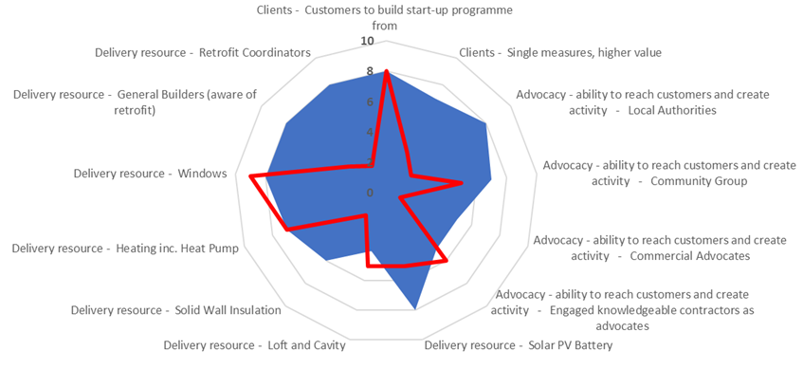
Retrofit One-Stop-Shop development
Minimum threshold for successful launch
2022 Y&NY assessment

Slide 24








Retrofit One-Stop-Shop for York (ROSSY)
Home Energy Assessments, Community Champions and Advisors
To create an end-to-end, digital, home energy retrofit platform that
will provide the following components:
Referrals to Grant-funding and CYC-specific Finance
Customer &
Supplier retrofit Engagement and Empowerment
Monitoring, Evaluation, Aftercare and Feedback Service
Demonstrator Homes and Monitoring
Recommended Supplier Marketplace and Network
Replication of the Business Model
Scale-up and Investment

Slide 25
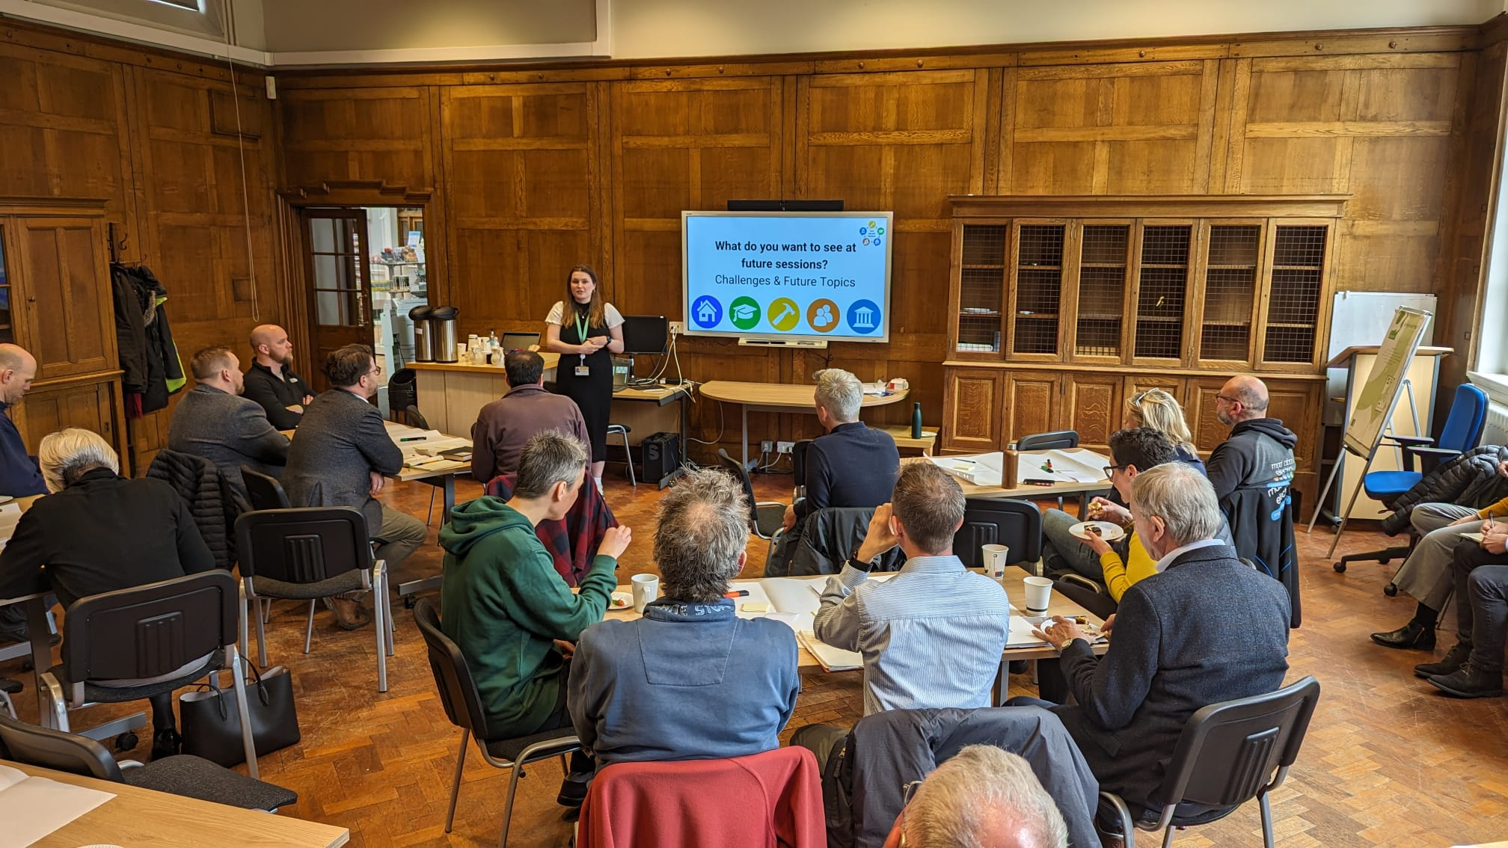
York Retrofit Network
Purpose:
To reach across the supply chain, including those who are not already engaged and grow the supply chain
To share knowledge and best practice
To foster a public-private sector partnership and collaboration
Encourage suppliers to join YorEnergy
Opportunities for the network:
Learn more about opportunities for work
Gain knowledge and access to skills opportunities
Meet others in the supply chain
Gain insight into the plans of local leaders
Be linked into YorEnergy and become part of the trusted supplier base

Slide 26
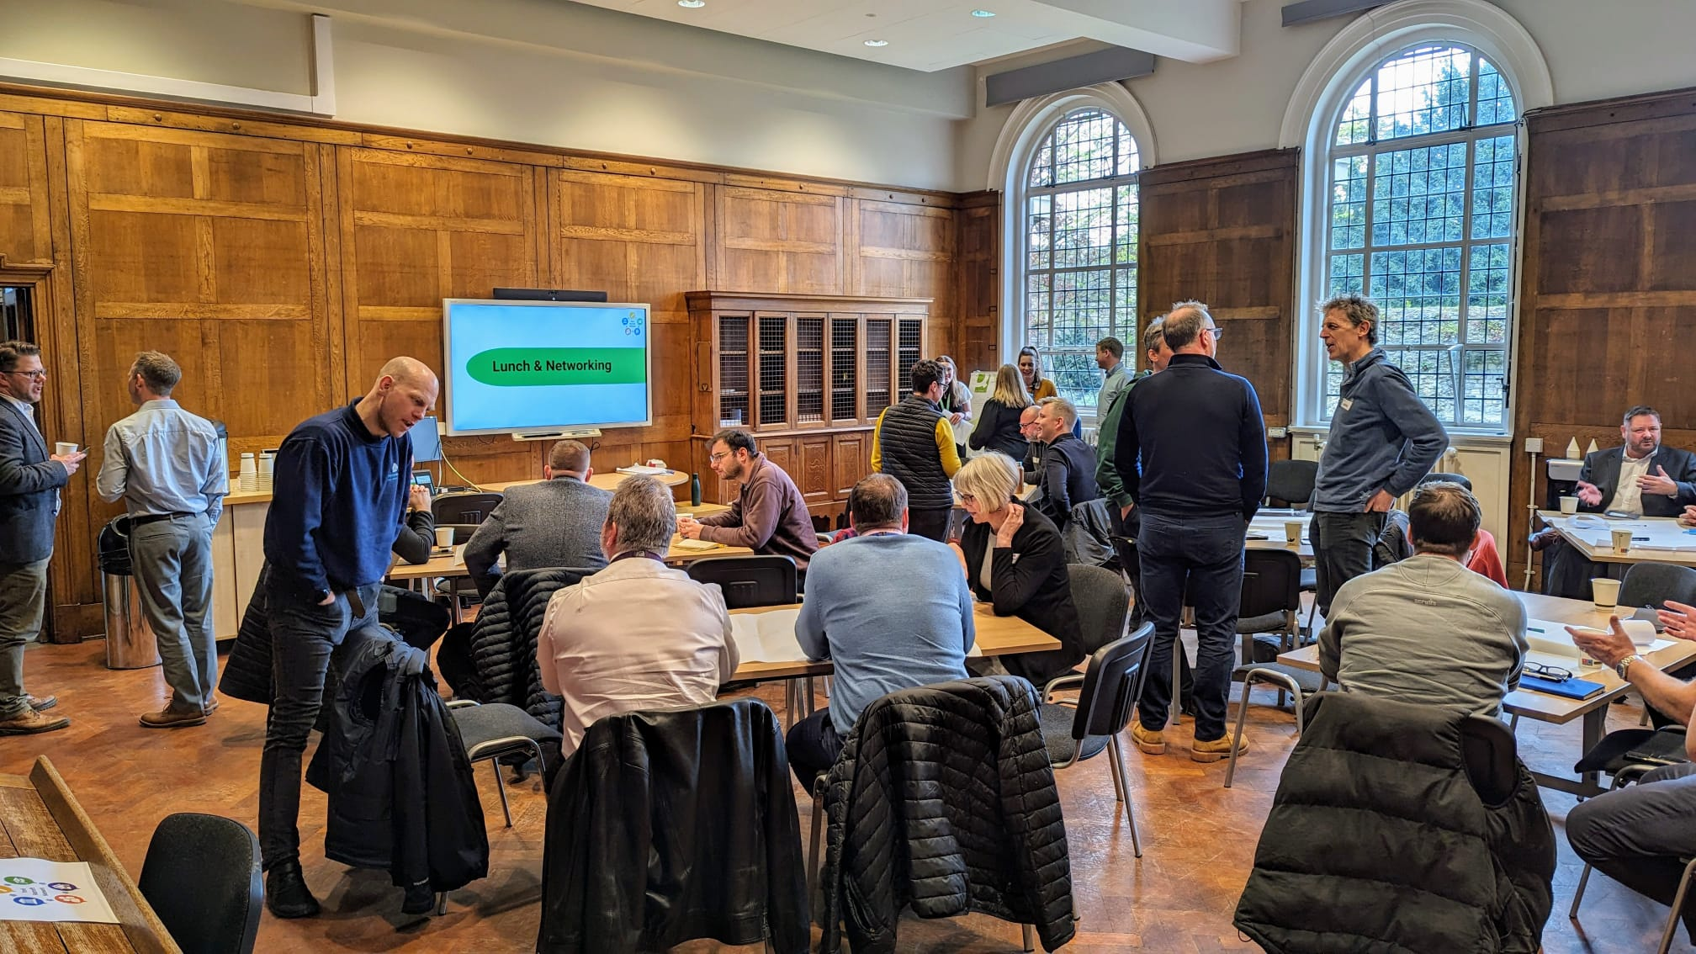
York Retrofit Network
Sessions to date:
Introduction to Retrofit
Accreditation/training
Heritage Retrofit
Future sessions:
Other One-Stop-Shops
Upskilling staff
Engaging with residents

Slide 27
Challenges
Lack of clear, consistent communication | Range of fees within the supply chain | Consumer understanding of the journey and value for money | Demographic of potential customers – affluent and 55+, need motivation and finance
Free assessments could wipe out other suppliers | Future maintenance and support | Planning/heritage permissions | Fear of the unknown/change
People gaps e.g. architecture/builders | Need for soft skills | Need for householder assurance | Need for consumers to understand tech

Slide 28
York Retrofit Network
We admittedly rather nervously attended the first session in May 2024 and we soon found the atmosphere mainly due to Lucy and the teams' very warm welcomes to be both relaxing, reassuring and comfortable. As we all know, we are naturally a bit nervous at first when joining a room full of folk you don’t know, but this quickly subsided and we were surprised at how many organisations and companies had the same/similar views and aspirations as we did, and even more so that we knew and have since gone on to explore further relationships with!
Since starting our learning journey/transformation way back in 2006, we kind of ‘get it’ however, it was a fantastic to see so many likeminded folk attend such a vibrant and fair open forum.
In short, 'don’t miss it next time''
It was 'interesting, engaging and extremely useful'
YRN is 'an excellent initiative that will benefit the City of York'
YRN needs 'to be talked about and celebrated'

Slide 29


Slide 30
Malcolm Ramsay
Project Manager – Let Zero, South Yorkshire Combined Authority

